Slide 1
Agents introductions using Langchain

Slide 2
What is Agent?
The core idea of agents is to use a language model to choose a sequence of actions to take. In chains, a sequence of actions is hardcoded (in code). In agents, a language model is used as a reasoning engine to determine which actions to take and in which order.
And as seen below, the agent creates a chain in real-time, reflects on the question, and goes through a process of action, observation, thought, action, observation, thought...until the final answer is reached.

Slide 3
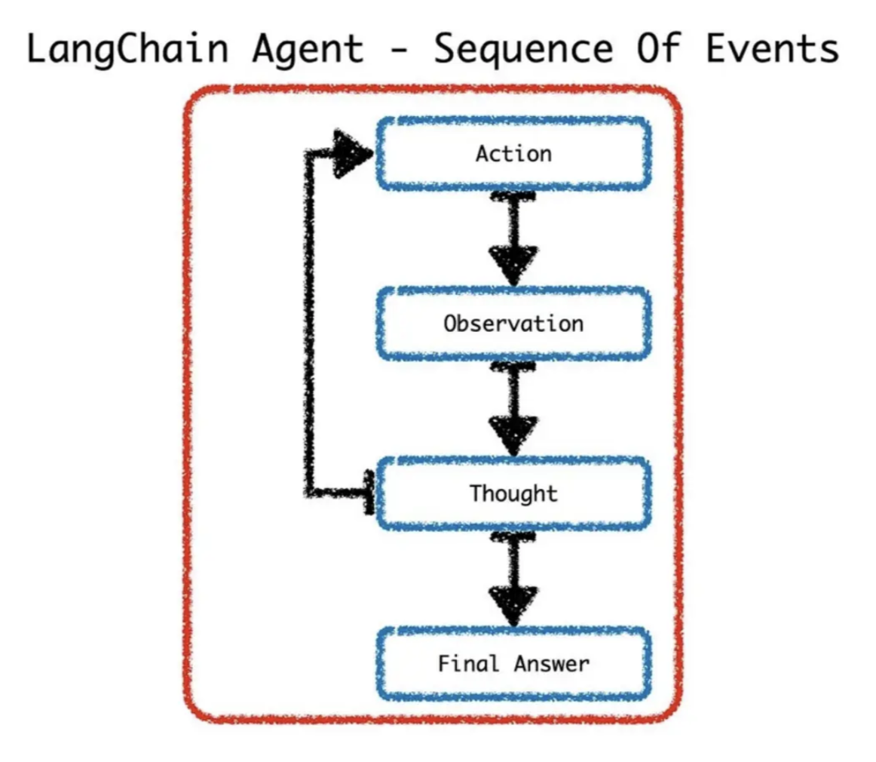

Slide 4
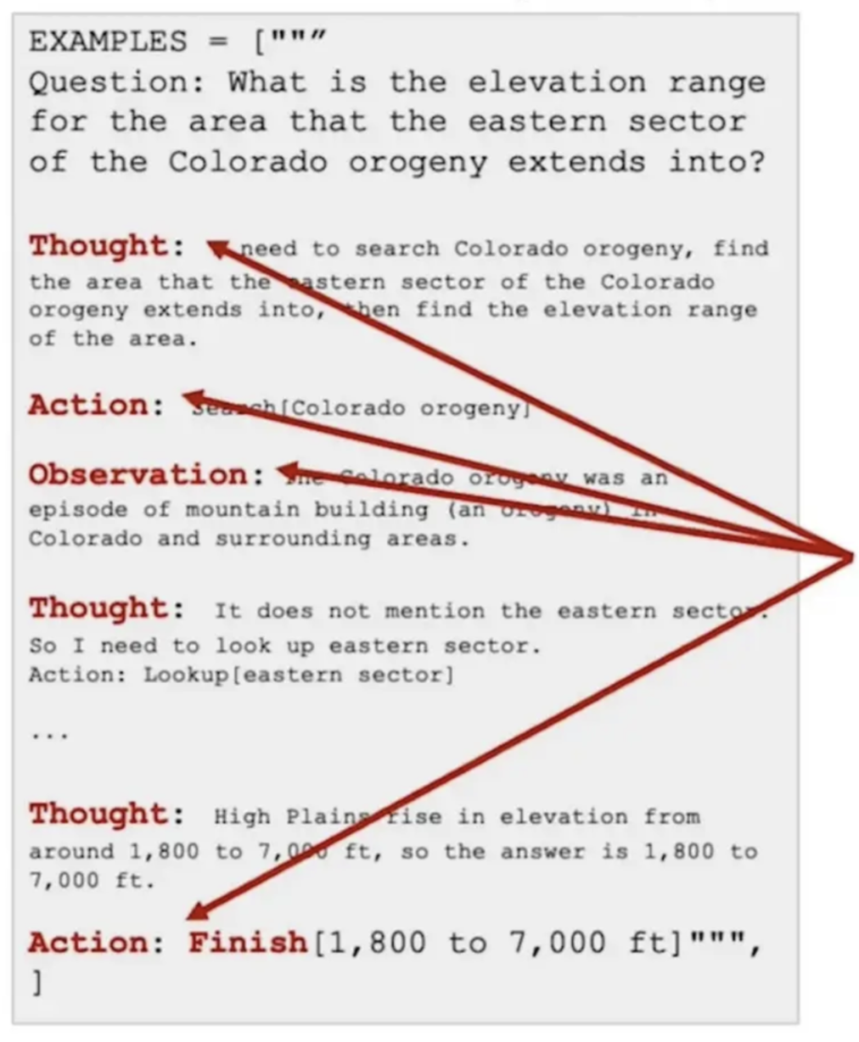
LangChain output parsing works with prompt templates
LangChain library functions parse the LLM's output assuming that it will use certain keywords.
Example here uses Thought, Action, Observation as keywords for Chain-of-Thought Reasoning. (ReAct)

Slide 5
What are Tools?
In LangChain, an "Agent" is an AI entity that interacts with various "Tools" to perform tasks or answer queries. Tools are essentially functions that extend the agent's capabilities by allowing it to perform specific actions, like retrieving the current time or accessing an external database.
Agents let the model use tools in a loop, so that it can decide how many times to use tools.

Slide 6
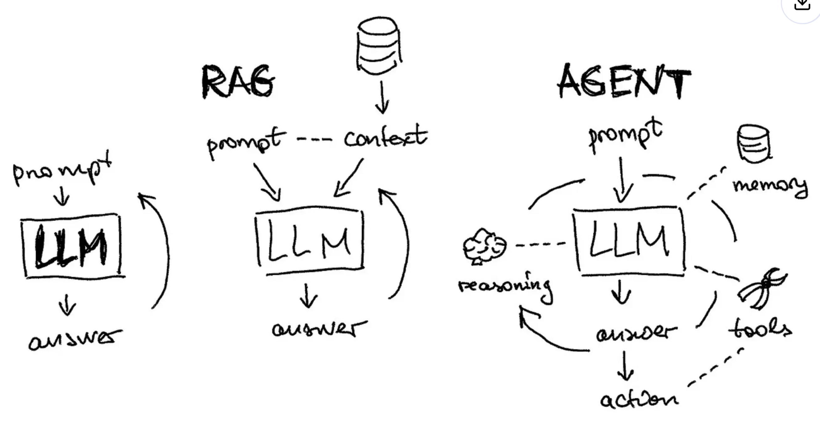
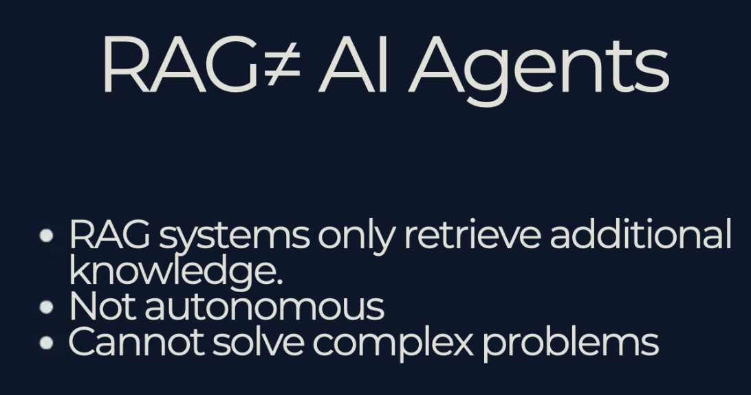
LLM/ RAG / AGENT
﻿﻿An agent with a Tool
﻿﻿Can make decisions; act as reasoning engines.
﻿﻿Interact with Tools.
﻿﻿Autonomous, doesn't need constant human input.
As a consequence, it is able to autocorrect itself when any errors appear (if trained well).

Slide 7
AI Agent vs AI Automation
Al Automation:
Follows fixed rules to complete specific, repetitive tasks.
﻿﻿Reacts based on predefined workflows.
Al Agents:
﻿﻿Can make decisions and take actions independently.
﻿﻿Flexible, adapts to new situations and learns from interactions.

Slide 8
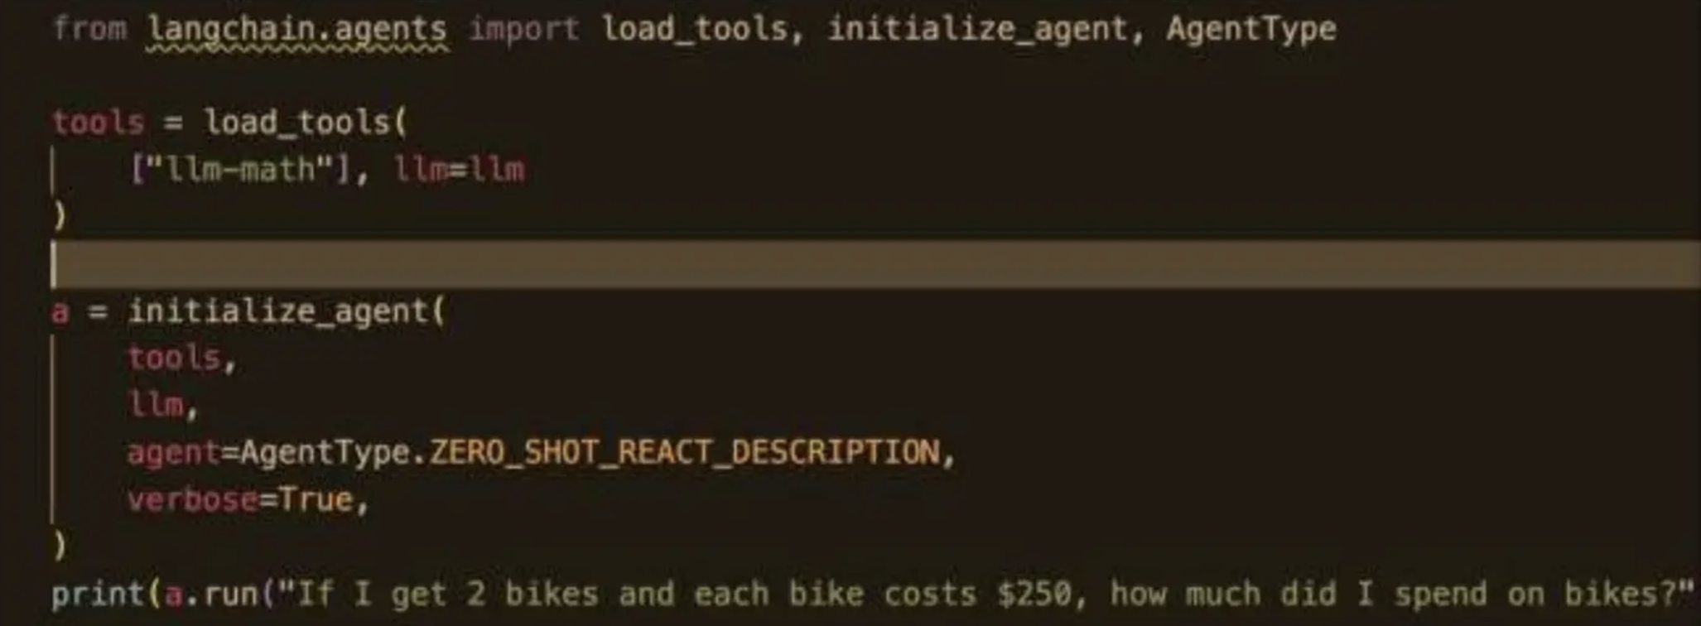
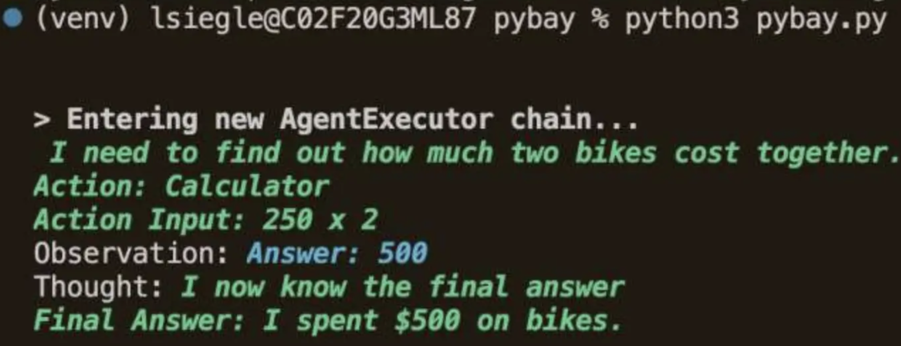
Code

Slide 9
Create prompt and tool for the agent
prompt = ChatPromptTemplate.from_messages( [ ( "system", """ You are a research assistant that will help generate a research paper. Answer the user query and use neccessary tools. Wrap the output in this format and provide no other text\n{format_instructions} """, ), ("placeholder", "{chat_history}"), ("human", "{query}"), ("placeholder", "{agent_scratchpad}"), ] ).partial(format_instructions=parser.get_format_instructions())
tools = [search_tool, wiki_tool] agent = create_tool_calling_agent( llm=llm, prompt=prompt, tools=tools)

Slide 10
Run & Test the Agent
question = "Tell me about Action Park?" agent_executor = AgentExecutor(agent=agent, tools=tools, verbose=True) raw_response = agent_executor.invoke({"query": question}) structured_response = parser.parse(raw_response.get("output")[0]["text"]) print(structured_response)

Slide 11
Types of Agents or Agentic Patterns
﻿﻿﻿Tool Calling
﻿﻿﻿Structure Output
﻿﻿﻿Human in Loop
﻿﻿﻿Map- Reduce
﻿﻿﻿MultiAgents
﻿﻿﻿Planning
﻿﻿﻿Reflection(Reflex Agents)
﻿﻿﻿ReAct Agent(Learning Agents)
﻿﻿﻿Hierarchical Agents

Slide 12
Benefits of AI Agents
﻿﻿﻿Enhanced Efficiency and Productivity
﻿﻿﻿Improved Decision-Making
﻿﻿﻿24/7 Availability and Scalability
﻿﻿﻿Personalized Customer Experiences
﻿﻿﻿Cost Reduction and Increased Revenue
﻿﻿﻿Innovation and New Opportunities

Slide 13
Product Examples of Artificial Intelligent Agents
Intelligent Personal Assistants
Chatbots
Autonomous Robots
Game Playing Agents
Fraud Detection Agents

Slide 14
Built-in AI Agent Framework or Platform
1. AutoGen
2. Crewai
3. PhiData
4. Cogniflow
5. LangChain
6. Llama-Index
7. Vertex AI Agent Builder

